Slide 1

IINFOSYS STOCK MARKET FORECASTING

Slide 2

MENTOR
SALIM
GROUP-6, PROJECT-163
TEJESWINI
SHILPA MAHIMAN
SHUBHAM SAWANT
K.SAMBA SHIVA
MAITHILI KULKARNI

Slide 3
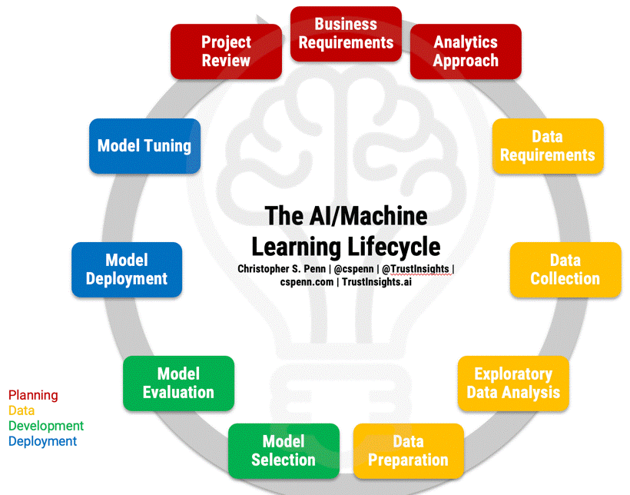

Slide 4
BUSINESS PROBLEM
BUSINESS OBJECTIVE
To predict the outcomes, trends, or expected future behavior of business, industry sector, or the economy using statistics.
Nowadays, the most significant challenges in the stock market is to predict the stock prices. The stock price data represents a financial time series data which becomes more difficult to predict due to its characteristics and dynamic nature.
In today’s world companies and businesses are very keen to understand and analyze the market to lower their expenses and enhance profits.
With modern data analytics, we can identify purchasing and selling patterns by carefully analyzing the data to help the investors.

Slide 5

Data Collection
Website: From Infosys Limited (INFY.NS) we have taken the historical data from 2016-04-01 to 2022-11-04.
Data Columns are : Open, Close, High, Low, Adj Close, Volume.
In stock Trading, the high and low refer to the maximum and minimum prices in a given time period.
Open and close are the prices at which a stock began and ended trading in the same period.
Volume is the total amount of the trading activity-adjusted values factor in corporate actions such as dividends, stock, splits, and new share insurance
We are mainly focusing on the Close columns and making forecasting based on the input.

Slide 6
Data Initial (Exploratory data Analysis)
We have data on working days only and so there are 1701 data with start date as 2016-01-01 and end date as 2022-10-04
Date is in Date time data types.
Close is in float64 data types.
Data set does not contain any null values.
Data set contains 1701 rows and 1 columns .
Close
Date
2016-01-04 | 8.120000
2016-01-05 | 8.100000
2016-01-06 | 8.035000
2016-01-07 | 8.030000
2016-01-08 | 8.085000
... | ...
2022-09-28 | 17.110001
2022-09-29 | 16.900000
2022-09-30 | 16.969999
2022-10-03 | 17.049999
2022-10-04 | 17.700001

Slide 7
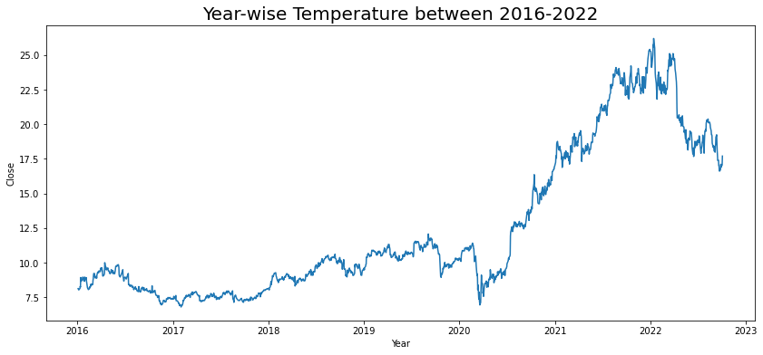
Line Plot tracking of Closing Price of Stock Over Periods of Years

Slide 8
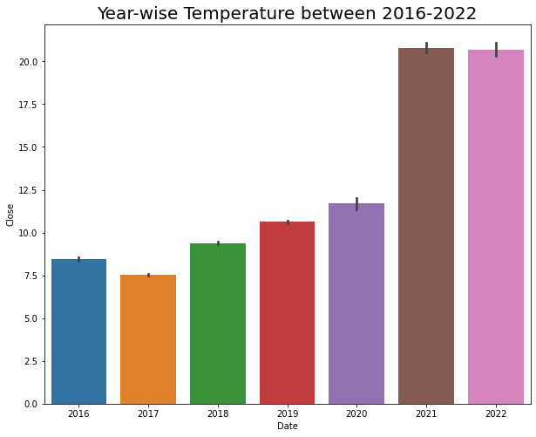
Data Visualization

Slide 9
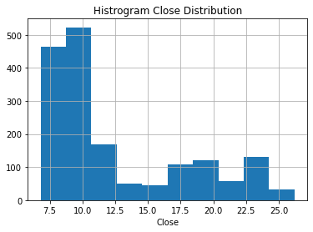
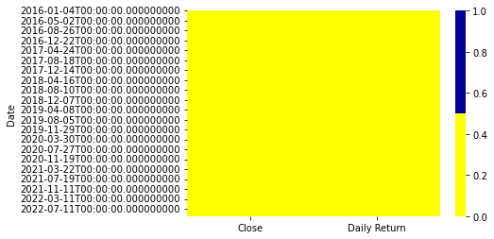
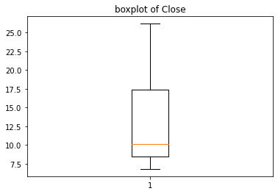
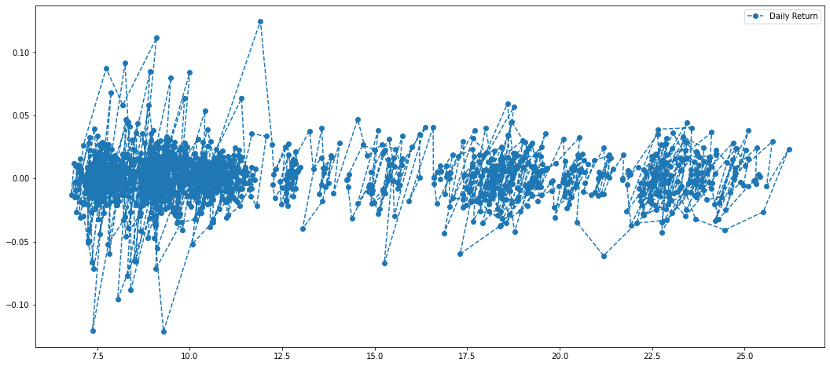
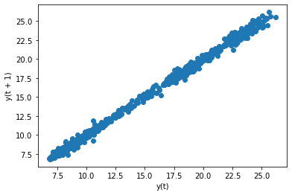
Heat Map Distribution
Percentage change for each day
Scatter Plot Close Distribution

Slide 10
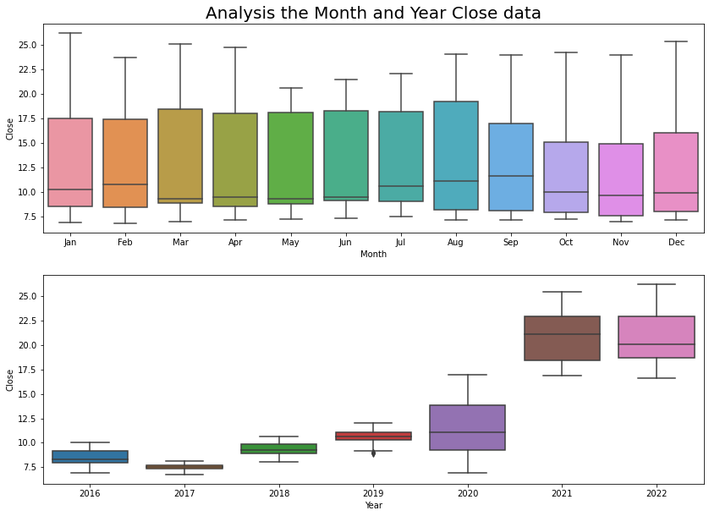
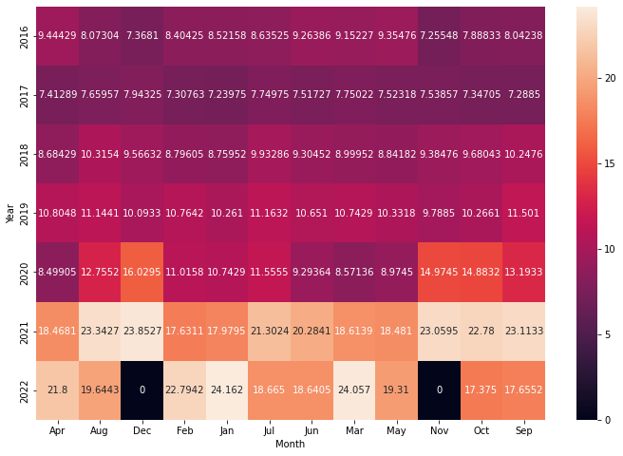

Slide 11
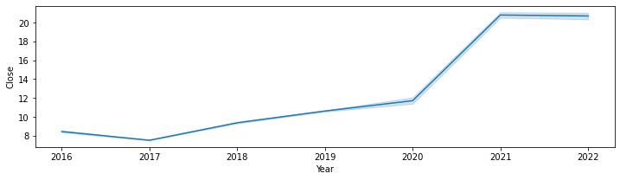
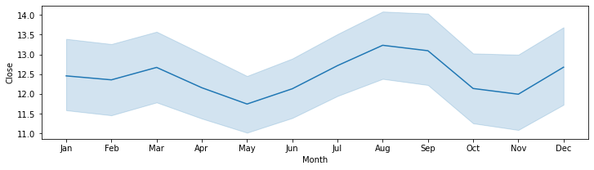
Yearly –wise and Month –wise Close Line Distribution

Slide 12
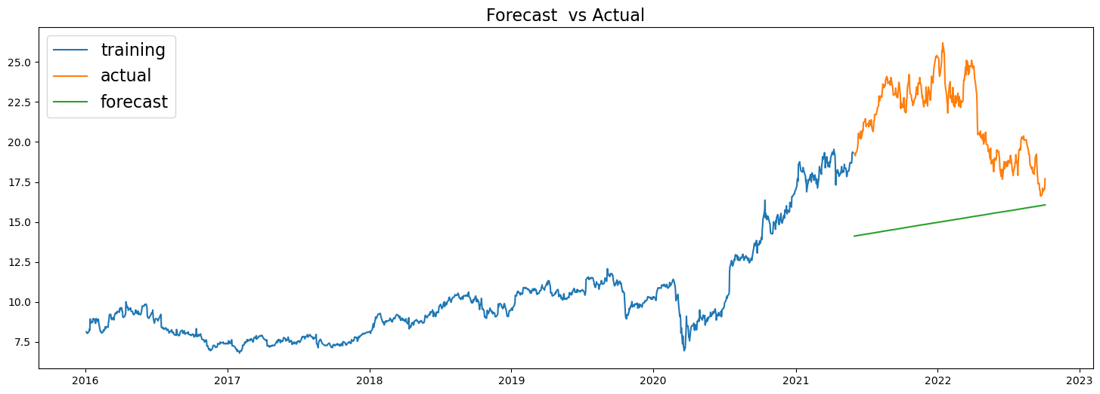
Linear Model
RMSE Value of Linear Model : 6.9432
MAPE Value of Linear Model : 28.8582

Slide 13
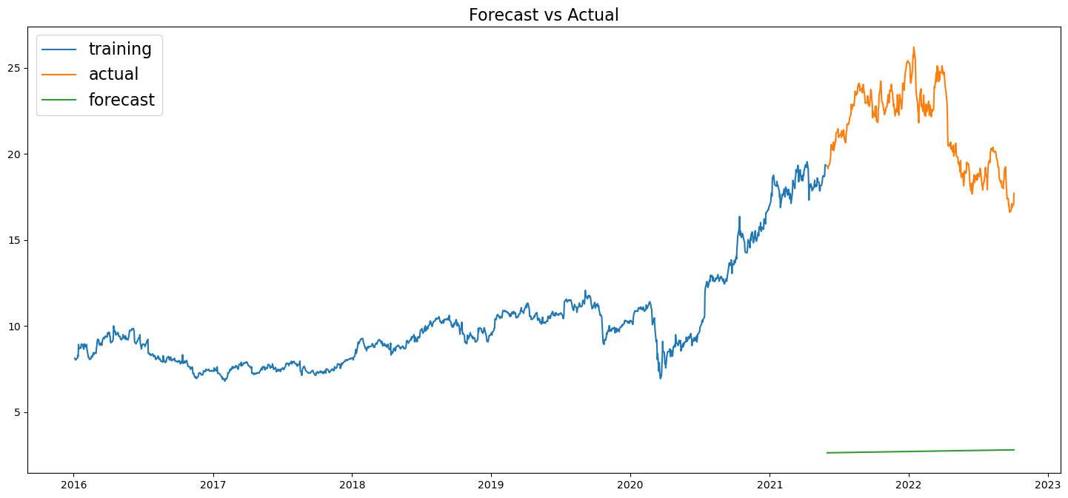
Exponential Model
RMSE Value of the Exponential Model : 6.5361
MAPE Value of the Exponential Model :28.4705

Slide 14
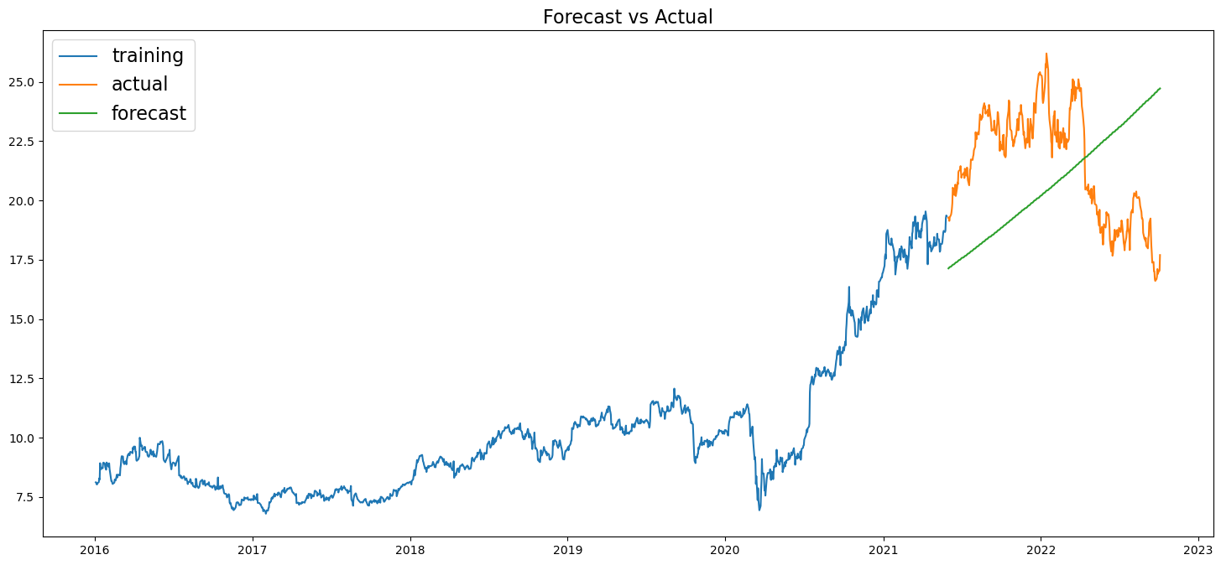
Quadratic Model
MAPE Value of Quadratic Model : 18.1200
RMSE value of Quadratic Model : 4.0501

Slide 15
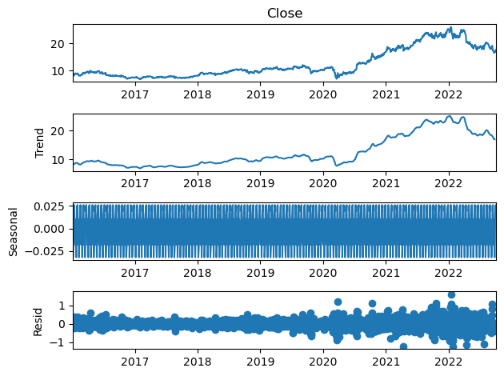
Time Series Decomposition plot
LEVEL : First plot shows the average value in the series
TREND : Show the increasing or decreasing value in the series and has a Non linear trend
SEASONALITY : Show the repeating short-term cycle in the series and now is stationary
RESID : Shows the random variation in the series

Slide 16
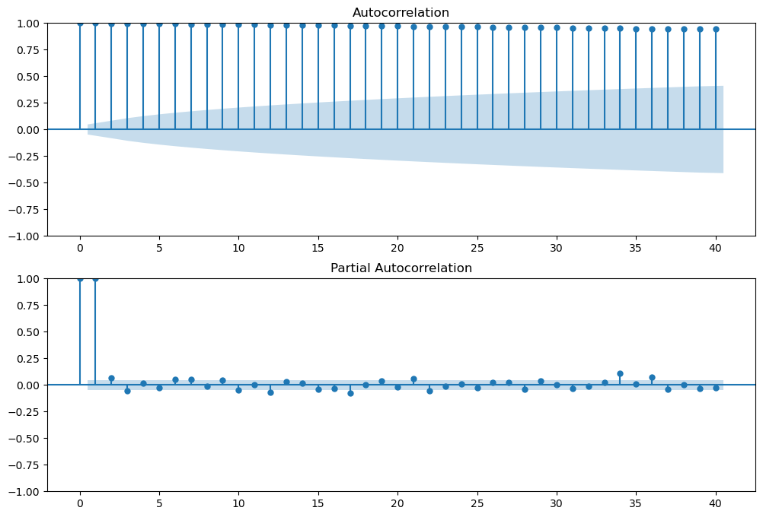
ACF & PACF PLOT
Autocorrelation Function (ACF) : It is a measure of the correlation between the time series with a lagged version of itself
Partial Autocorrelation Function (PACF) : This measures the correlation between the time series with a lagged version of itself but after eliminating the variations already explained by the intervening comparisons.
Gradual Decline in ACF Plot
Sharp Dropoff in PACF Plot

Slide 17
MODEL EVALUATION - BUILDING
DATA DRIVEN MODELS :
1. Simple Exponential Method
2. Holt’s Method
3. Holt’s Winter Exponential Smoothing with Additive Seasonality and Additive Trend
4. Holt’s Winter Exponential Smoothing with Multiplicative Seasonality and Additive Trend
5. Holt’s Winter Exponential Smoothing with Multiplicative Seasonality and Multiplicative Trend
MODEL BASED METHODS :
1. Linear Model
2. Exponential Model
3. Quadratic Model
ARIMA MODEL (Non-Stationary Dataset & Stationary Dataset)
Auto- Regressor Model
Moving Average Model
LSTM Model

Slide 18
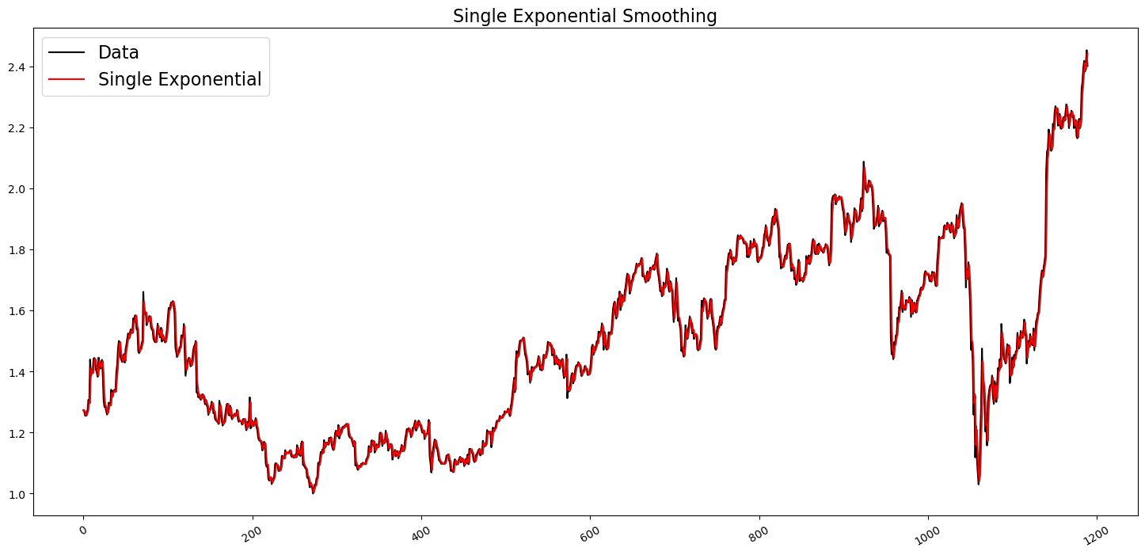
SINGLE EXPONENTIAL METHOD
Single Exponential Smoothing works on weighted averages i.e. the average of the previous level and current observation. Largest weights are associated with the recent observations and the smallest weights are associated with the oldest observations.

Slide 19
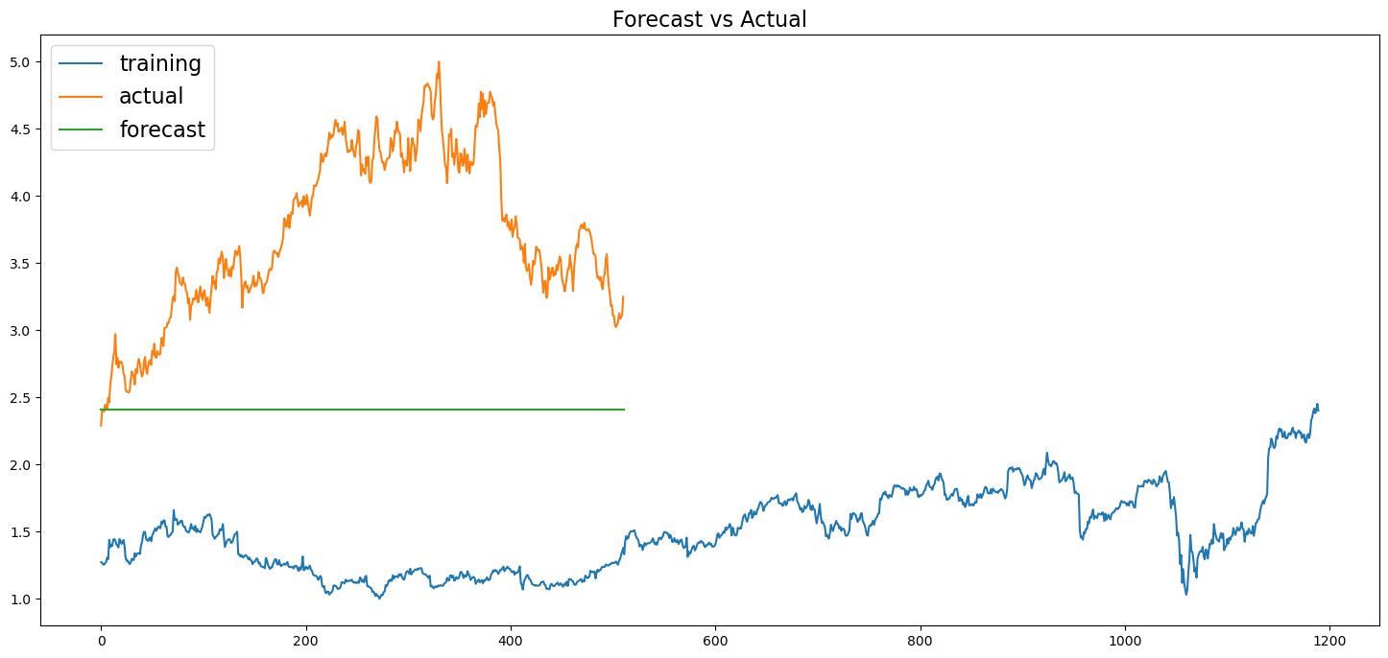

Slide 20
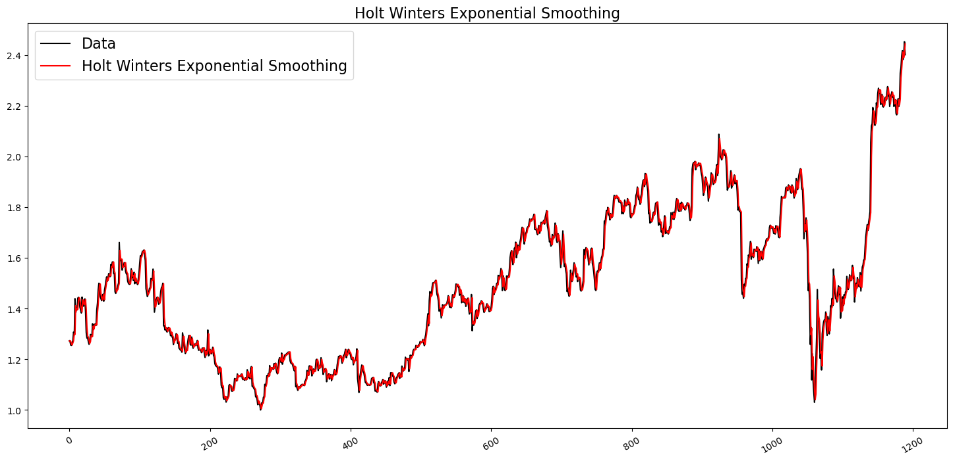
HOLT’S METHOD EXPONENTIAL SMOOTING
Expanding the Simple Exponential Smoothing method, the Holt’s method helps you to forecast time series data that has a trend

Slide 21
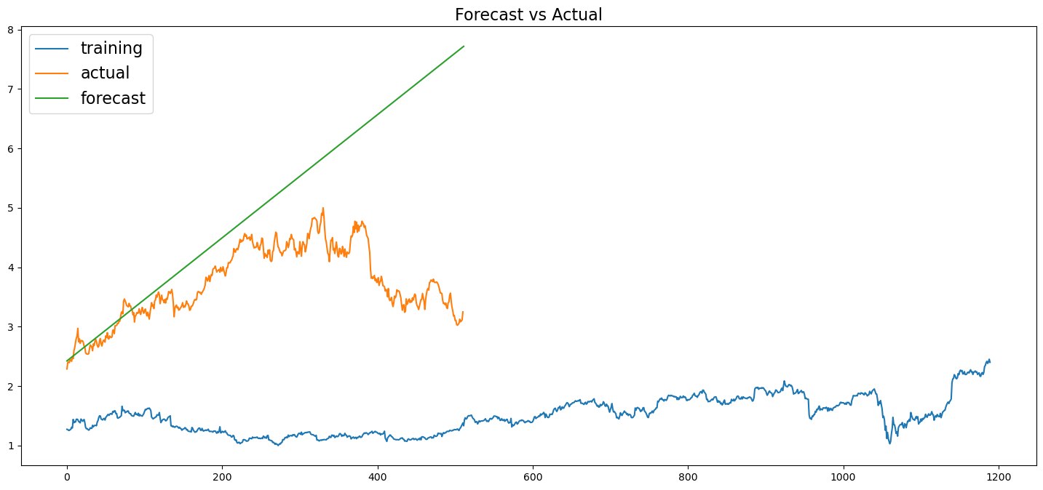

Slide 22
HOLT WINTER’S SEASONAL METHOD
The Holt-Winters model extends Holt to allow the forecasting of time series data that has both trend and seasonality, and this method includes this seasonality smoothing parameter.
There are two general types of seasonality: Additive and Multiplicative.
Additive: = Trend + Seasonal + Random Seasonal changes in the data stay roughly the same over time and don’t fluctuate in relation to the overall data.
Multiplicative= Trend * Seasonal * Random The seasonal variation changes in relation to the overall changes in the data. So, if the data is trending upward, the seasonal differences grow proportionally as well.

Slide 23
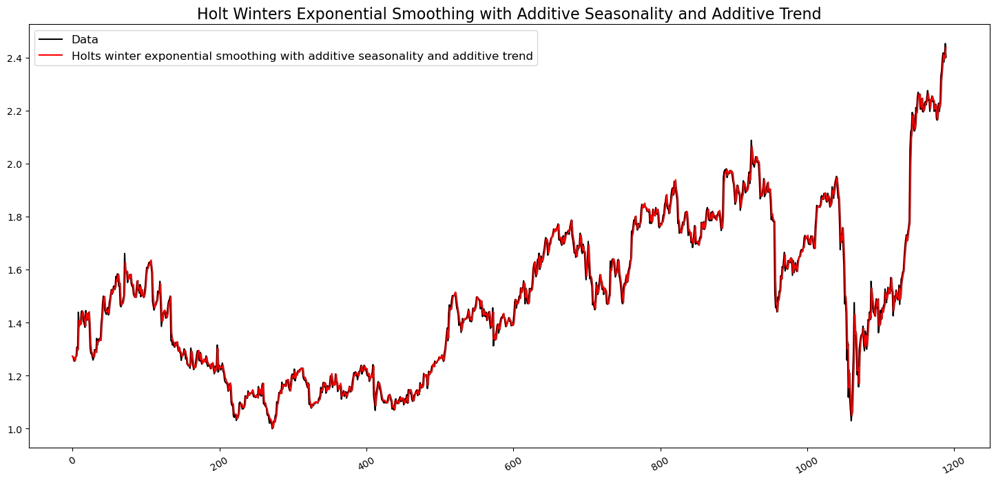
HOLT WINTER’S SEASONAL METHOD WITH ADDITIVE SEASONALITY AND ADDITIVE TREND

Slide 24
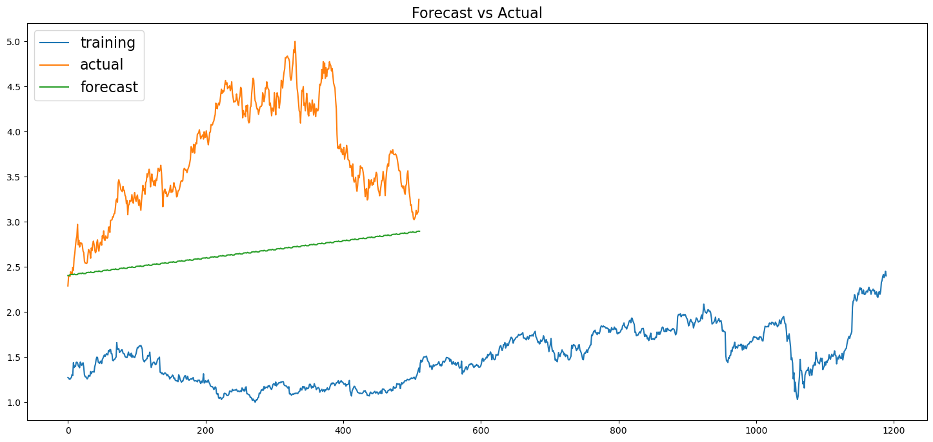

Slide 25
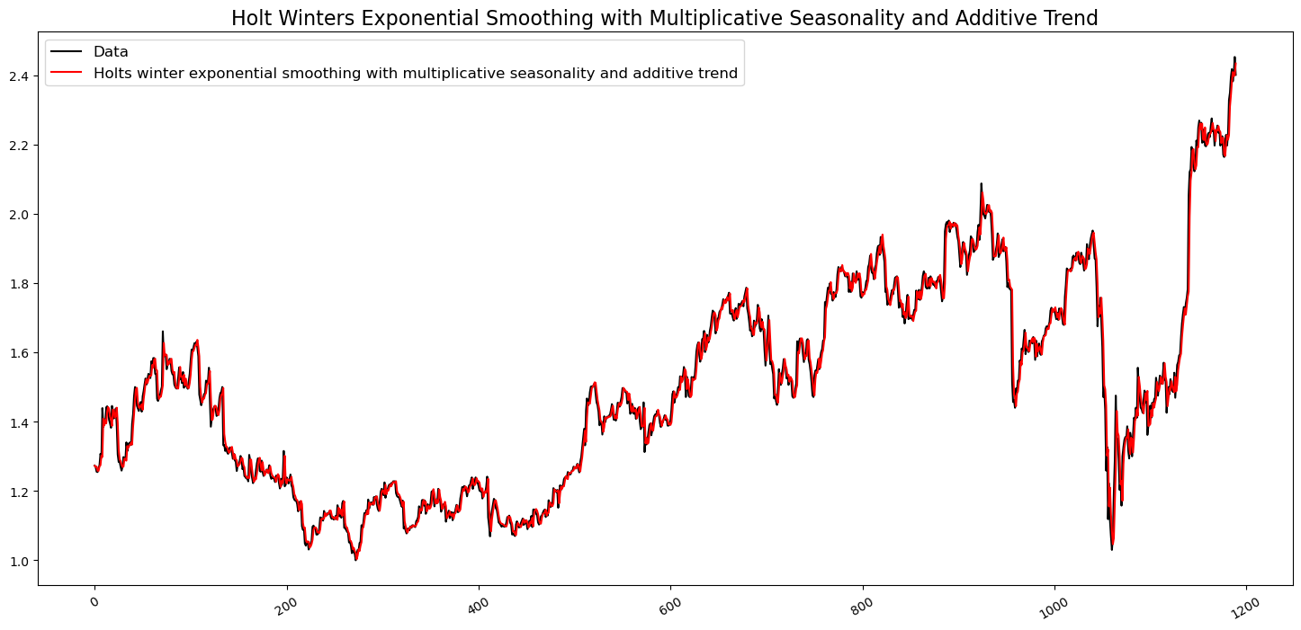
HOLT WINTER’S SEASONAL METHOD WITH MULTIPLICATIVE SEASONALITY AND MULTIPLICATIVE TREND

Slide 26


Slide 27
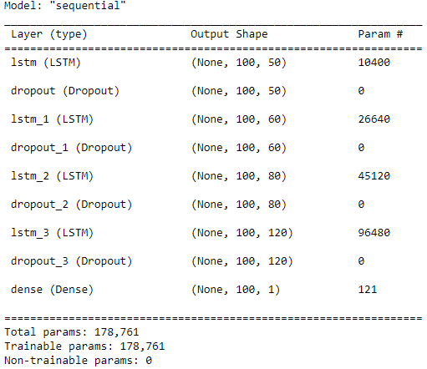
LSTM MODEL
Long short-term memory (LSTM) is an artificial recurrent neural network (RNN) architecture used in the field of deep learning (DL). Unlike standard feedforward neural networks, LSTM has feedback connections.

Slide 28
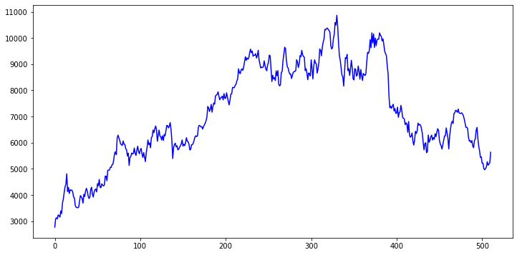

Slide 29
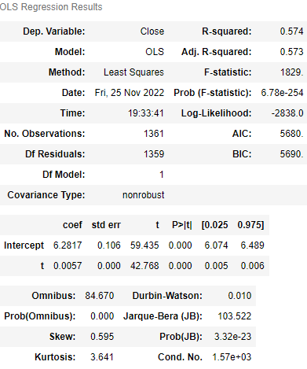
LINEAR MODEL
Standard Errors assume that the covariance matrix of the errors is correctly specified
The condition number is large, 2e+03. This might indicate that there are strong multicollinearity or other numerical problems

Slide 30
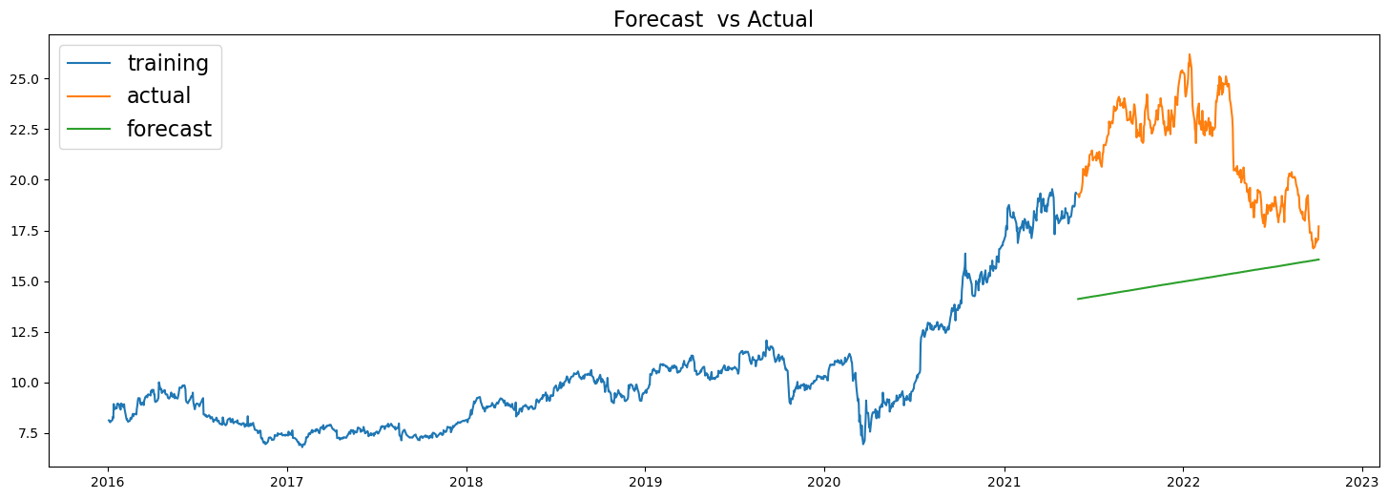

Slide 31
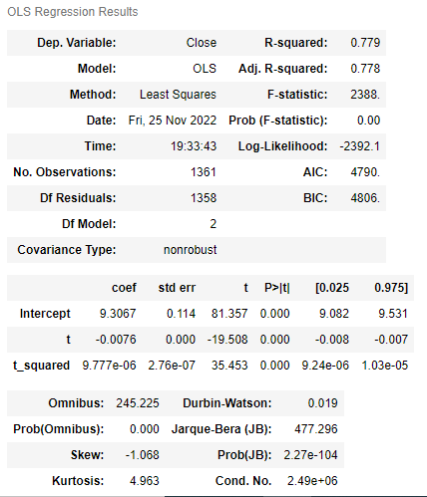
QUADRATIC MODEL
Standard Errors assume that the covariance matrix of the errors is correctly specified
The condition number is large, 4.04e+06. This might indicate that there are strong multicollinearity or other numerical problems

Slide 32
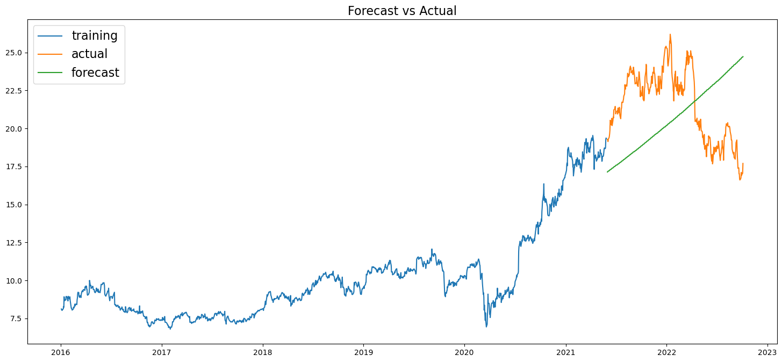

Slide 33
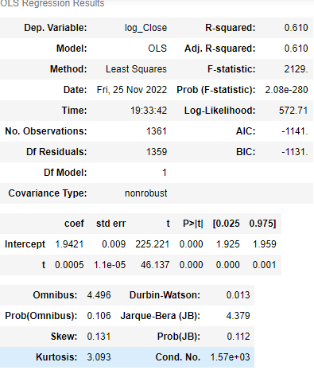
Exponential Model
Standard Errors assume that the covariance matrix of the errors is correctly specified
The condition number is large, 2e+03. This might indicate that there are strong multicollinearity or other numerical problems

Slide 34
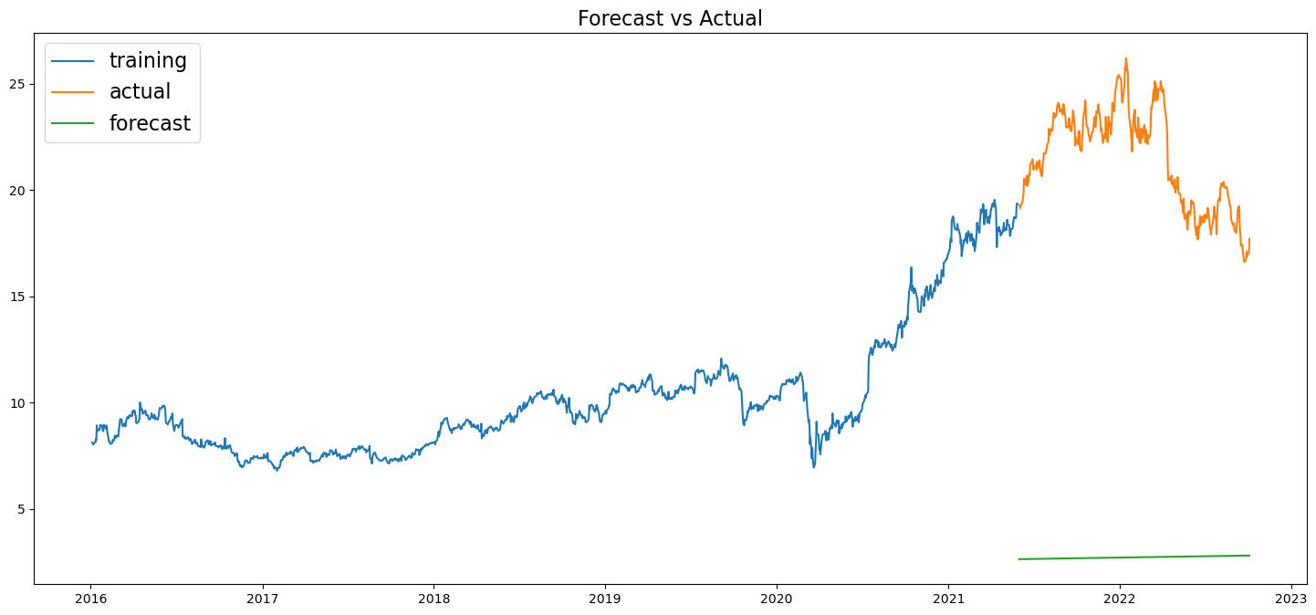

Slide 35
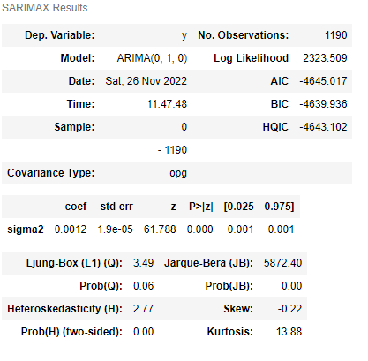
ARIMA MODEL (NON-STATIONARY DATA)
We have performed Grid search for hyper-parameters to find out optimal order or (p, d, q) for ARIMA Model (Non-Stationary Dataset)
Best order found is (1, 0, 1) with least RMSE = 0.048

Slide 36
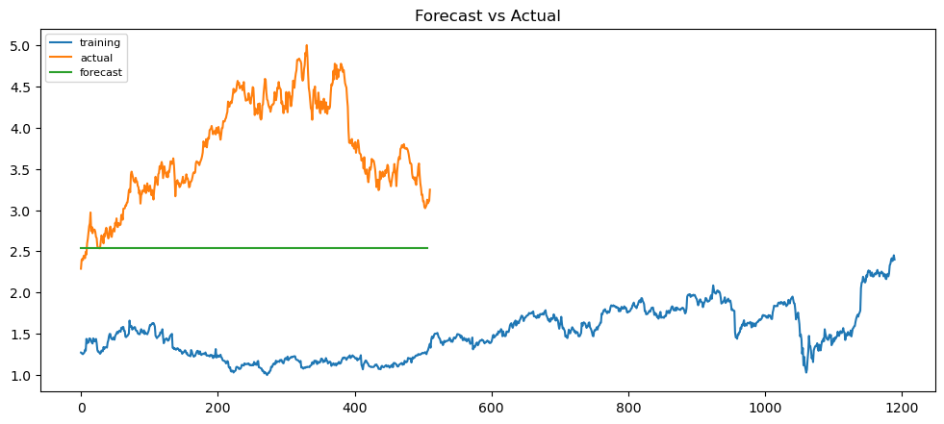

Slide 37
FORECASTING MODELS (STATIONARY DATA-SET)
ARIMA MODEL
AUTO – REGRESSOR MODEL
MOVING AVERAGE MODEL

Slide 38
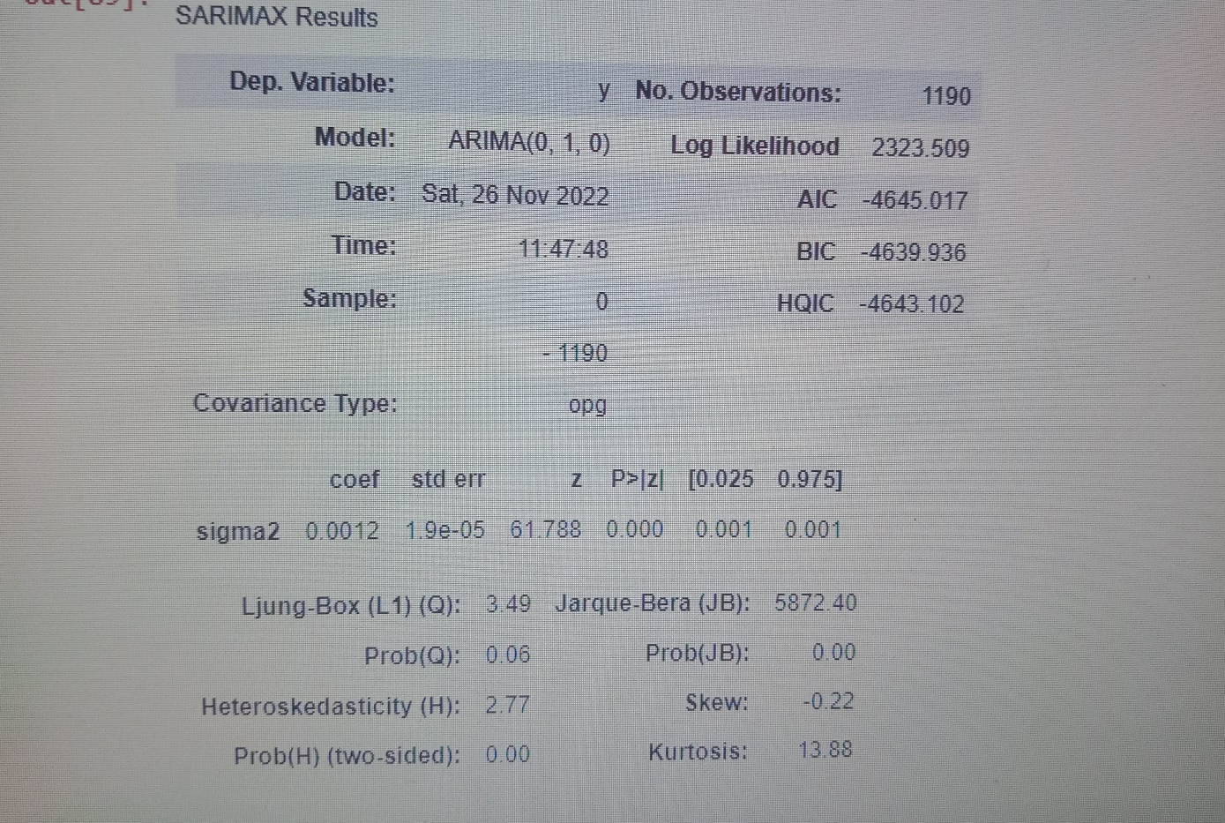
ARIMA MODEL (STATIONARY DATA)
We have performed Grid search for hyper-parameters to find out optimal order or (p, d, q) for ARIMA Model (Stationary Dataset)
Best order found is (1, 0, 1) with least RMSE = 0.048

Slide 39
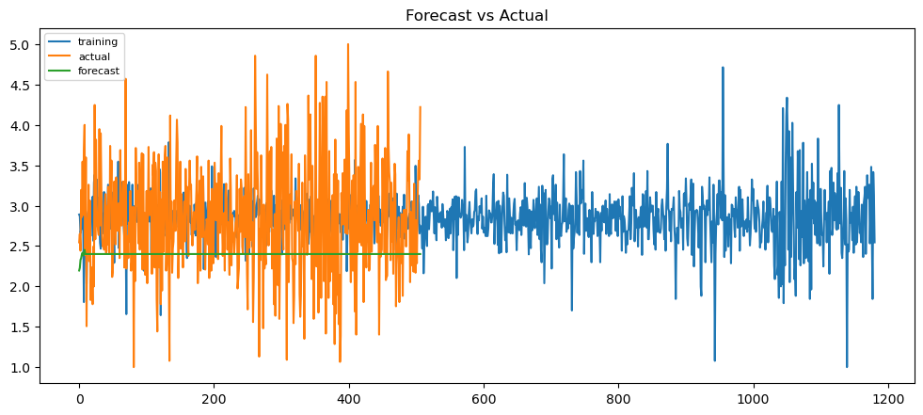

Slide 40
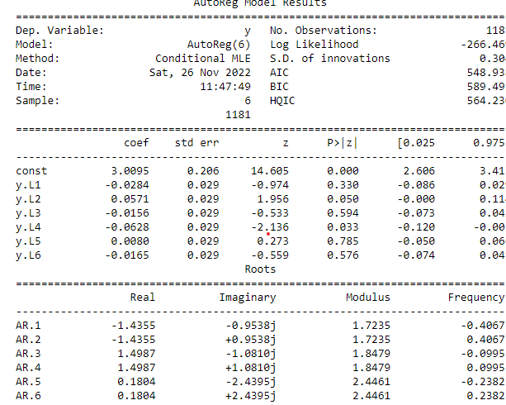
AUTO-REGRESSOR MODEL (STATIONARY DATA)
An autoregressive (AR) model predicts future behavior based on past behavior. It’s used for forecasting when there is some correlation between values in a time series and the values that precede and succeed them.

Slide 41
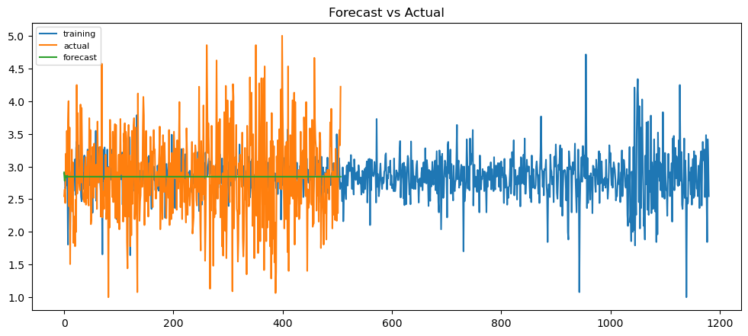

Slide 42
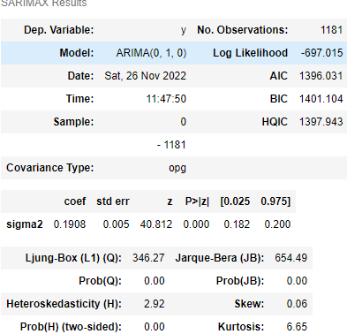
MOVING-AVERAGE MODEL (STATIONARY DATA)
The moving average model is a time series model that accounts for very short-run autocorrelation. It basically states that the next observation is the mean of every past observation. The order of the moving average model, q, can usually be estimated by looking at the ACF plot of the time series.

Slide 44
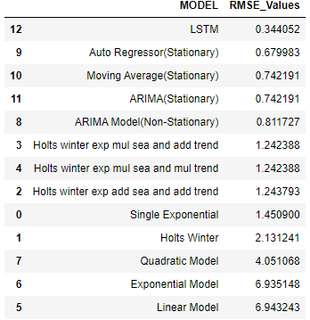
After computing all the models we concluded that Long Short Term Memory (LSTM) Model is best model for our predictions and forecasting as it is having the least RMSE Value (RMSE = 0.2475)

Slide 45
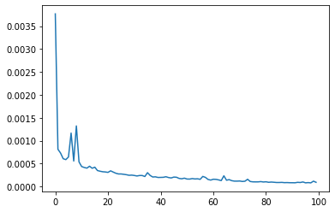
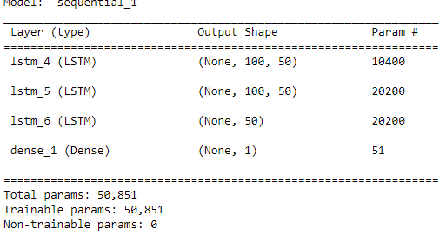
Long short-term memory (LSTM) is an artificial recurrent neural network (RNN) architecture used in the field of deep learning (DL). Unlike standard feedforward neural networks, LSTM has feedback connections.
We have build a Sequential model with Linear Activation, Adam as a optimizer and Mean Square Error as loss which is decreased drastically.

Slide 46
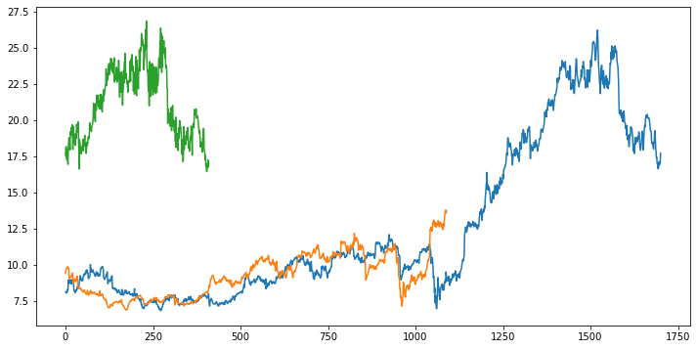
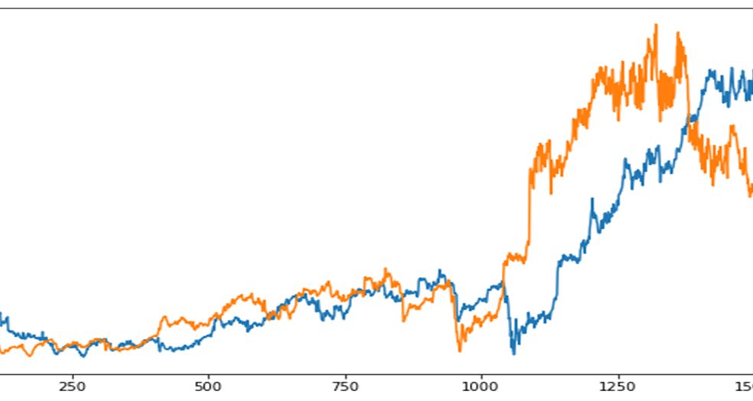
Blue Color – Original Dataset Orange Color – Predicted Train Dataset Green Color – Predicted Train Dataset
We have combined predicted train and predicted test dataset and represented it in a single graph on right.
As we can see the offset between predicted and original dataset is small we conclude that the model is predicting the almost correct values.

Slide 47
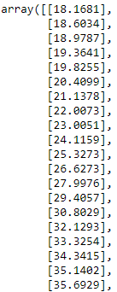
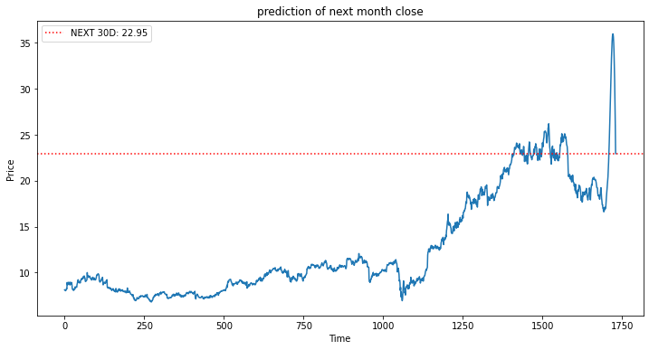
The Forecasting Graph for the Next Month Closing Price is shown with respect to the actual values.
And from the forecasting graph and array data we can conclude that there is a drastic fall in the market.

Slide 48
DEPLOYMENT

Slide 49
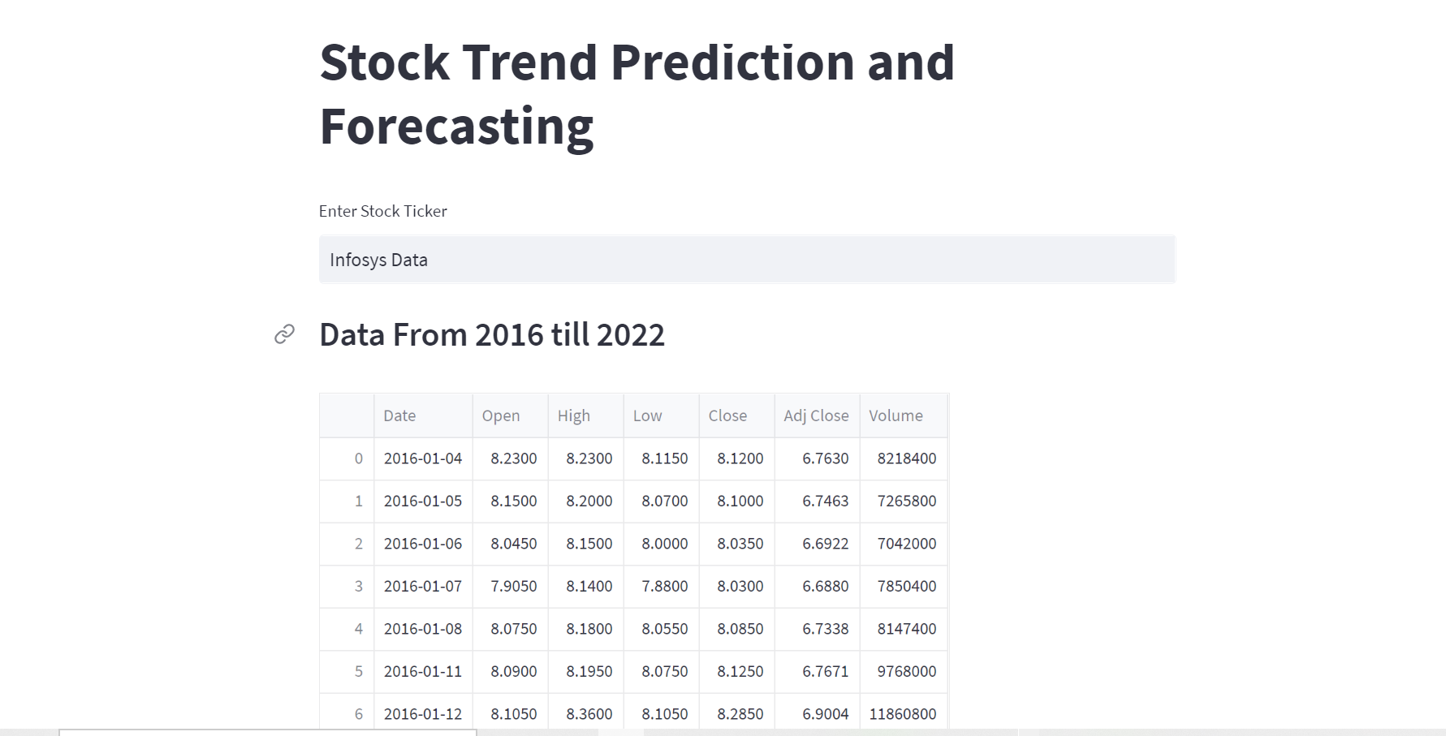

Slide 50
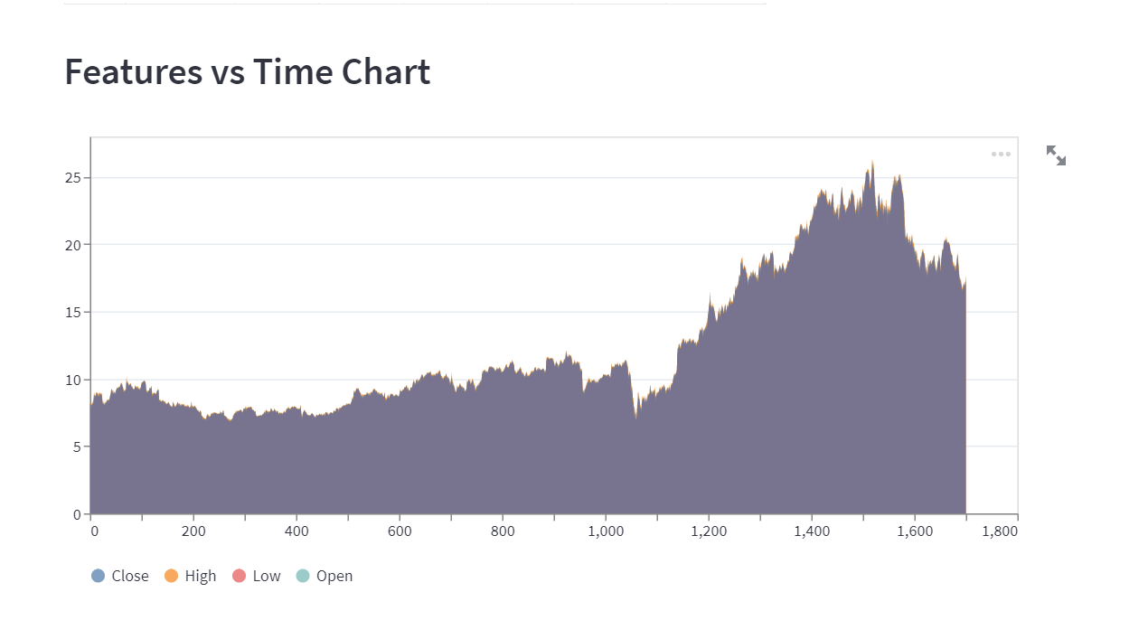

Slide 51
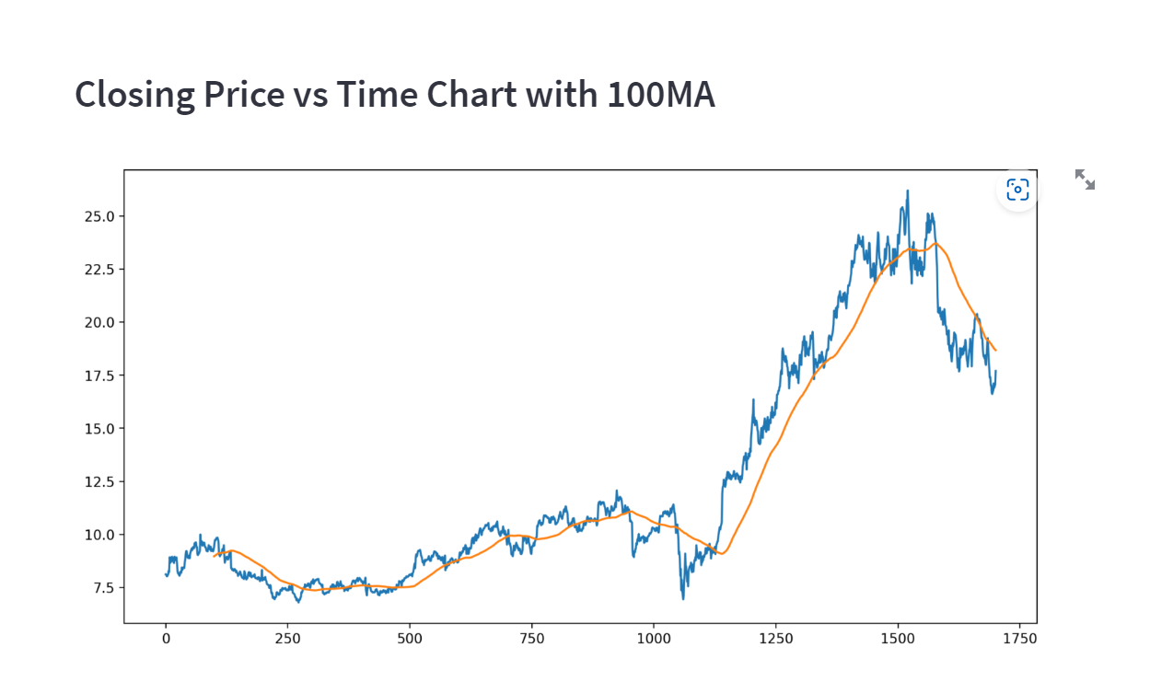

Slide 52
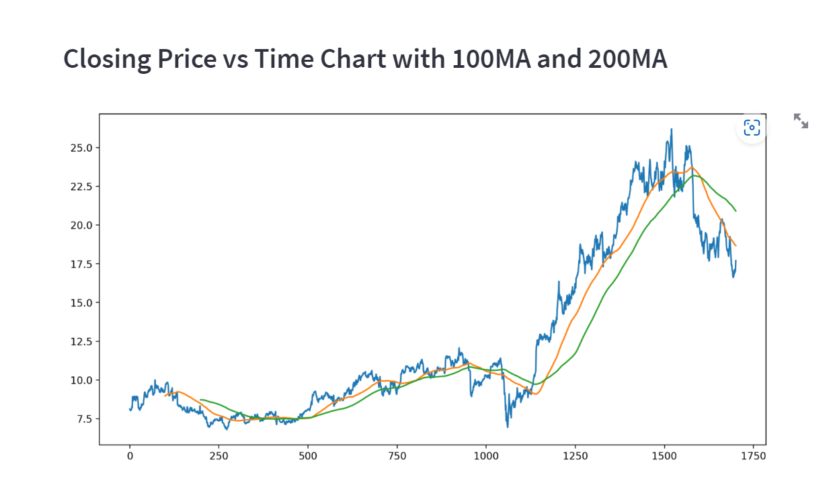

Slide 53


Slide 54


Slide 55
THANK YOU

